Slide 1

Exclusive Case Studies on Supply Chain Management Case Study: Location Planning 25-Jan-2026

Slide 2
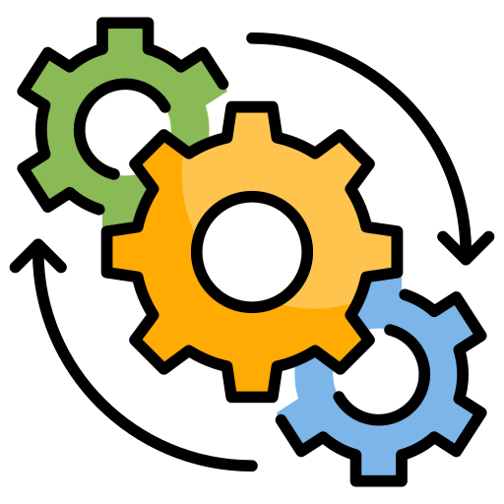
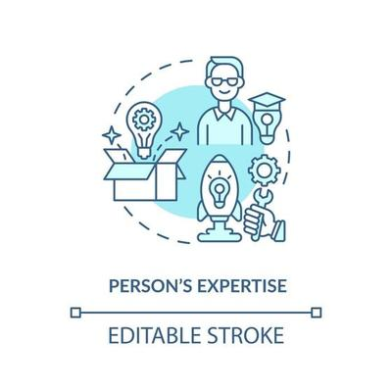






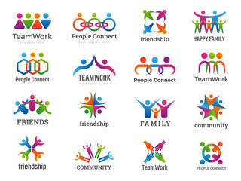
About SCM Connect Private Limited
Optimizing Supply Chains
7+ years in Operations
Our vision is to revolutionize Supply Chain Management by providing innovative solutions that focus on
Expertise in Supply chain Strategy and Planning, Supply chain-as-a-service, Data analytics & AI, Technology and Supply chain education
Cost Effectiveness
Clients across industry segments Manufacturing, Retail, e-Commerce, Consulting and Logistics
Well networked with partner ecosystem comprising of Technology, Logistics and Academic players
Enhance Efficiency
Multiple offices across India
Improve Visibility
20+ Professionals; Expertise in Supply Chain domain, Operations, Data Analytics and Technology

Slide 3





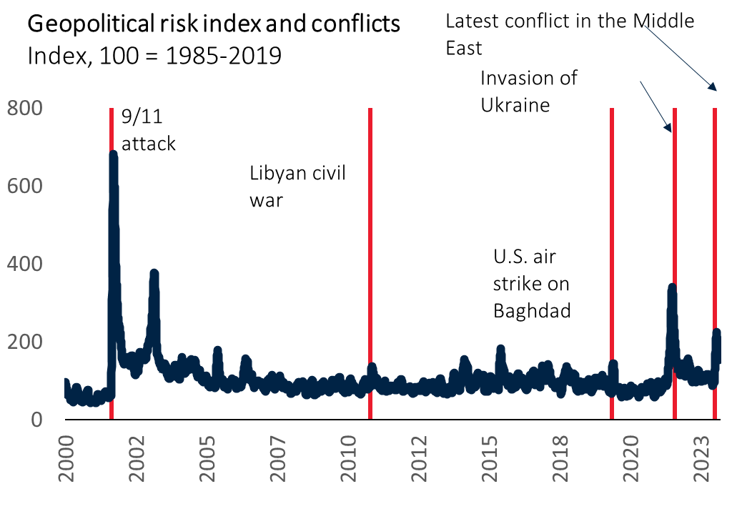
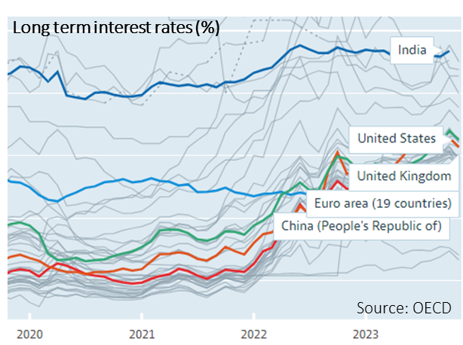
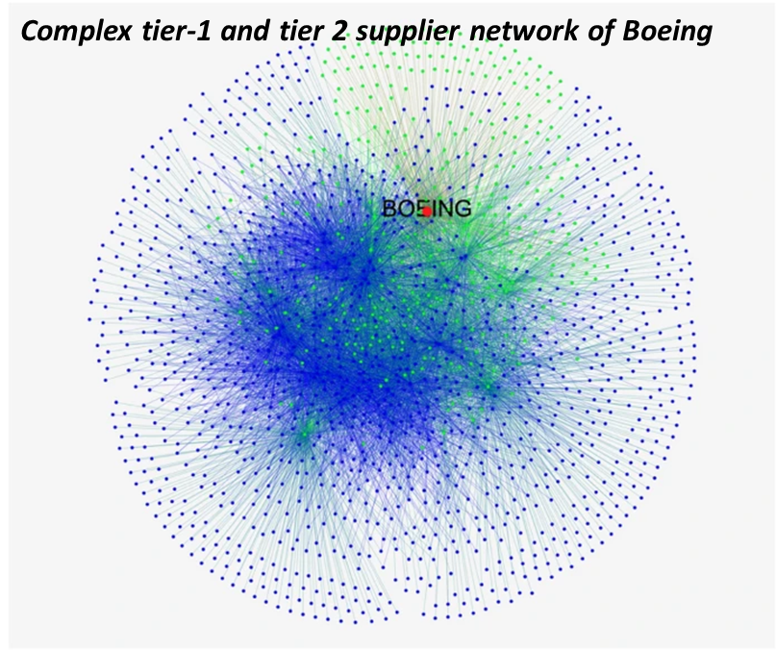
Increasing economic and political uncertainties and changing expectations of stakeholders…
1
2
3
4
5
Business shocks
Economic uncertainties
Global operating complexity
Changing customer expectations
Sustainability
More frequent business shocks due to interplay of climate change, pandemics, geo-political tensions.
Recent conflicts in easter Europe and the Middle East has disrupted global supply chains significantly
Economic uncertainties continues. Post pandemic recovery in global growth and falling inflation rates is surprisingly resilient
However, high interest rates will continue to weigh heavily on growth momentum
Evolving ‘China + many’ strategy offers significant opportunity
However, labor and logistics capacity constraints coupled with need for omni-channel presence and evolving ecosystem of players are increasing the complexity of supply chain
Customers expectations in terms of quality, timeliness and sustainability are evolving faster than expected
This is likely to put innovation and collaboration high on agenda within supply chain management
According to a Verint report, 44% of Gen Z and 43% of Millennial shoppers had to make more effort than expected to complete an interaction. This indicates that new generations have even higher expectations for their digital experiences
Rising expectations from regulators, customers and investors to minimize the environmental impact
High focus on sustainable supply chains in pursuit of “net zero”
>90% of publicly traded companies have adopted ESG reporting
According to Statista, consumers are 44% more likely to buy from a brand with a clear commitment to sustainability
Tier 1 Suppliers
Tier 2 Suppliers
Journal of International Business Studies

Slide 4





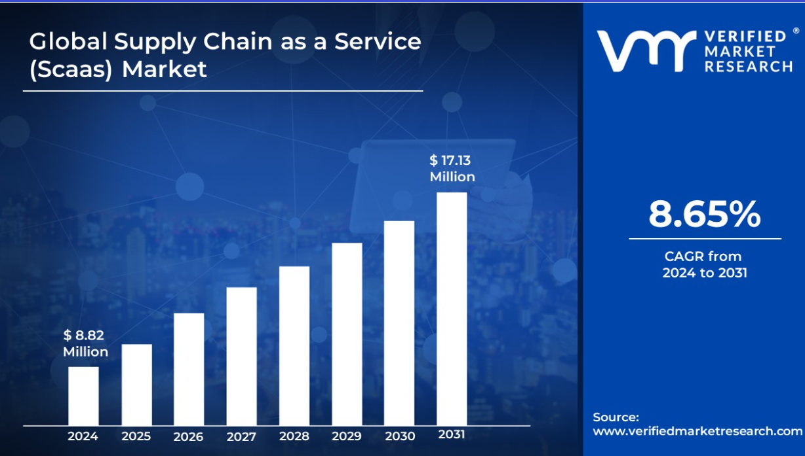
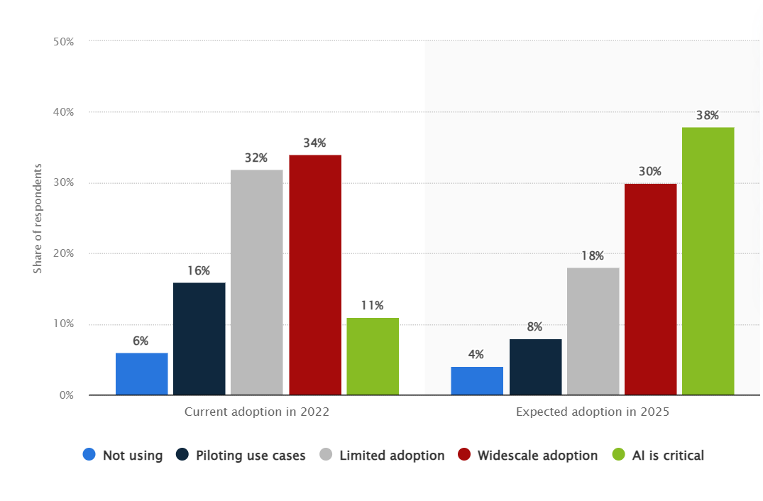
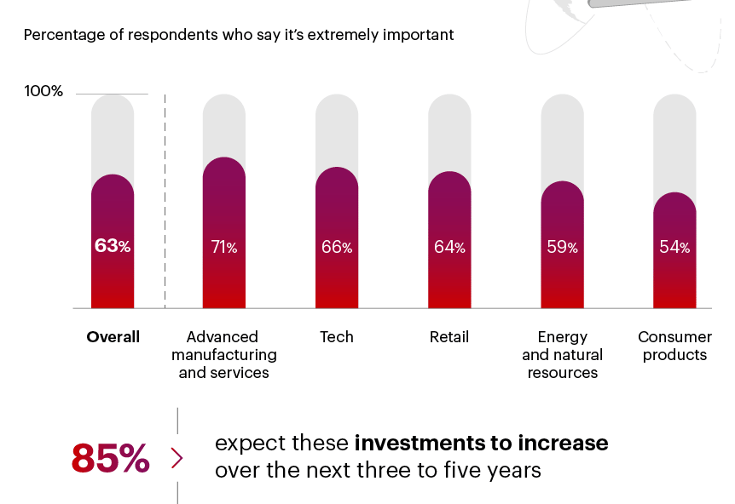
… are mounting pressure on supply chains to innovate and become more efficient.
1
2
3
4
5
Supply Chain As A Service
Data Analytics and AI
Digitalization
Circular Supply Chain
Risk Management
Need for agility, best practice adoption, end-to-end visibility, cost savings and resiliency is driving faster adoption of SCaaS
The global SCaaS market is expected to grow at 8.65% CAGR between 2024 and 2031
Future supply chains will be data and AI driven Analytics will reduce cost, increase visibility and improve customer experiences. AI is likely to augment quality, bring agility and automation of supply chains globally
Digital transformation of supply chain has become top priority to support new business, improve efficiency and productivity, enhance decision making and improve resiliency/agility amid ongoing supply chain disruption
A study by the Council of Supply Chain Management Professionals (CSCMP) has found that more companies than ever (93%) are actively engaged in digital transformation for a significant competitive advantage
Circular supply chain is likely to be a major trend driven by sustainability goals of reducing carbon emissions across the supply chain coupled with need to mitigate inflation risks, reduce wastage and respond to the return logistics requirements
A recent Gartner survey found that 74% of supply chain leaders expect profits to grow over the next two years as a result of applying circular economy principles
Being resilient and mitigating the risk is critical in an environment of economic uncertainties, increasing frequency of globally disruptive events, growing operational complexity, and rising instances of cybersecurity breaches and loss of IPs
Artificial intelligence (AI) adoption rate in supply chain in 2022 and 2025
Supply Chain Resiliency is important
Global Supply Chain as a Service Market size
Source: Verifiedmarketresearch.com
Source: Statista

Slide 5

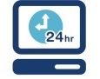
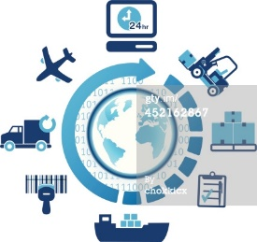
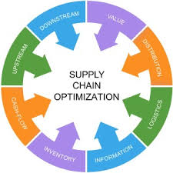

Service offerings
Strategy | Service | Data & AI | Technology | Training
Supply Chain Strategy & Planning
Supply Chain-as-a-Service
Data Analytics
& AI
Supply Chain
Technology
Supply Chain Training & Development
Supply Chain Strategy
Network Strategy & optimization
Inventory optimization
Procurement strategy
Supply Chain Risk Management
Opportunity assessment
Sustainability & ESG
Research & Intelligence
Demand Planning and Management
Sales & Operations Planning & Management
Inventory Planning & Management
Production Planning & Scheduling
Procurement Planning & Management
Supply Chain Data Strategy
Supply Chain Diagnostics
Supply Chain Analytics (AI, machine learning and advanced analytics)
Procurement Analytics
Supply Chain master data management
Data Governance
Visualization
AI adoption
Digital Supply Chain
Supply Chain Simulations
Supply Chain Apps and APIs
Supply Chain Visibility through RFID, QR codes and bar codes
Telematics
Solver Integrations for Optimization
Supply Chain Master Class
Bespoke learning programs
Utilizing modern methods including Gamification and Case Study based
Change Management
We extensively leverage the partner ecosystem to augment our capabilities in the areas of Technology and Operations

Slide 6
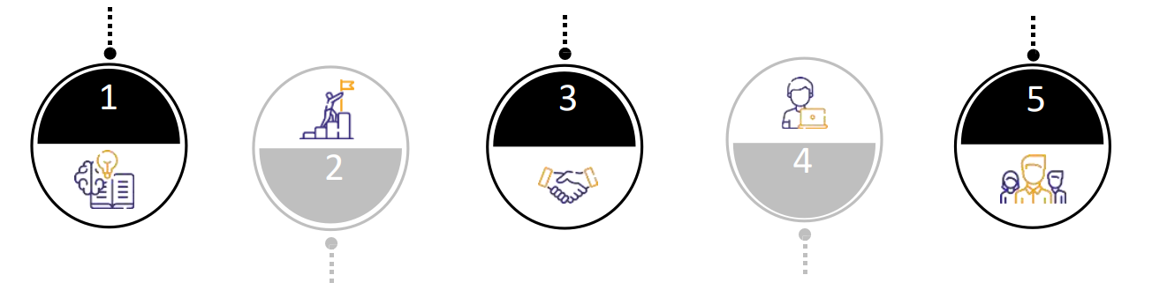

Why SCM Connect?
Flexible ways of working suiting specific requirements
Domain expertise
Extensive experience and know-how of managing and improving solutions through converged supply chain operations, data, technology and business expertise
High performing team
Skilled pool of resources, across supply chain domain; Matured processes to ensure talent management and development, and operations resilience
Delighted clients base
High concentration of repeat engagements (~90% ) ; highly satisfied clients with high Net Promoter Score
1
3
5
2
4
Commitment to success
Commitment and focus with the goal of “Work as One” team, having “courage”, “technical excellence” and “customer focused” as DNA
Best suited engagement models
Flexible engagement models as per client’s need with focus on outcome & continuous quality monitoring

Slide 7
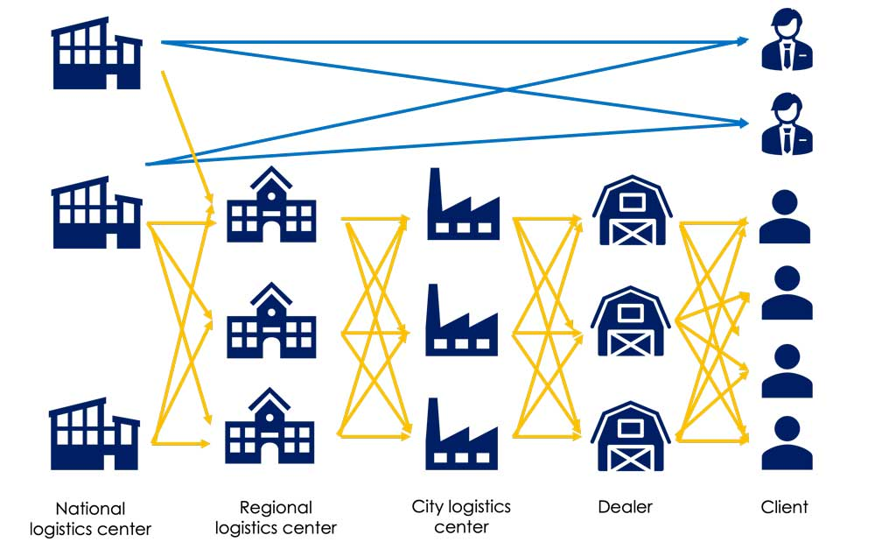
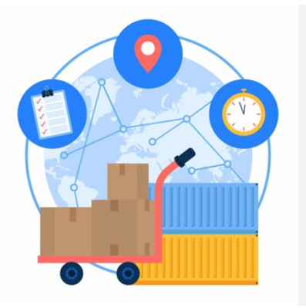
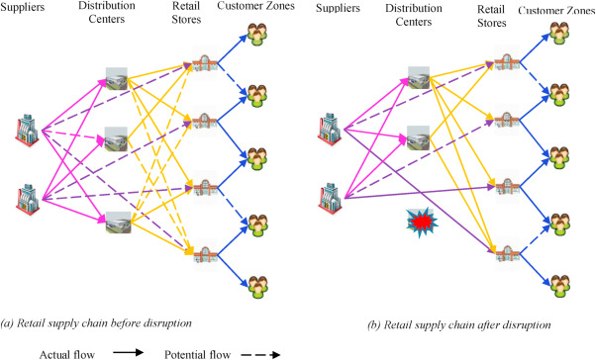
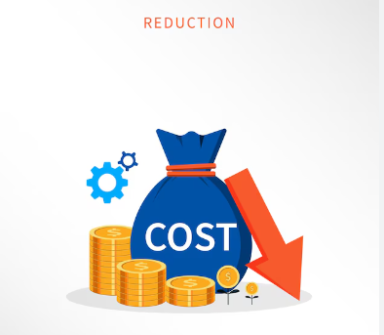
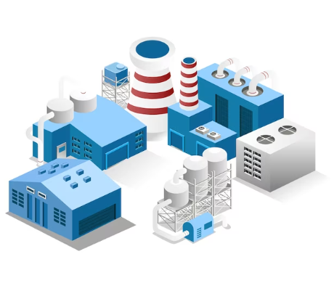
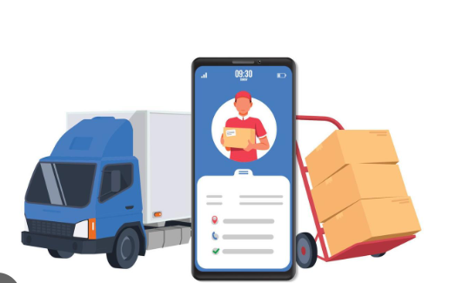
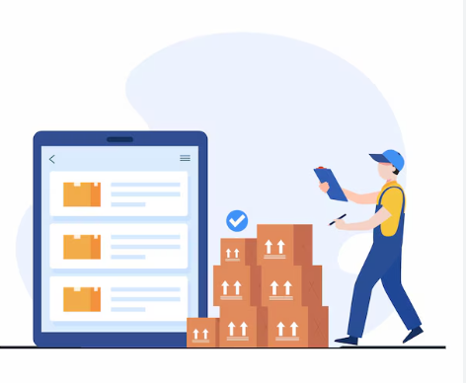
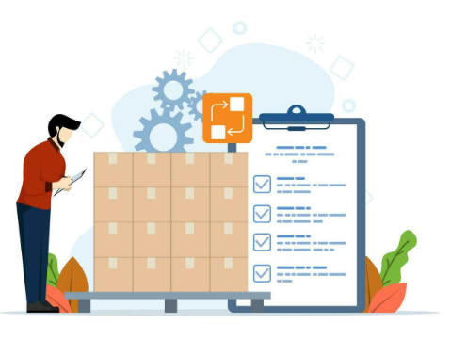
Case Studies
Cost Optimization | Efficiency Enhancement | Visibility Improvement
SUPPLY CHAIN NETWORK DESIGN INDUSTRY – Refrigerant Gas
SUPPLY CHAIN VISIBILITY INDUSTRY – FMCG
APPROACH : Supply Chain Network designed for next 5 years including OEMs and Trade, as per targtted SLAs
OEM 90% within 36 hrs and Trade 80% within 48 hrs
APPROACH : Implemented supply chain visibility solution for a French electrical MNC, integrating plant-to-customer tracking for two product lines and linking with loyalty program app.
RESULT : Cost Reduction of 16.71%
RESULT : 100% visibility of all SKUs on a single platform
SUPPLY CHAIN NETWORK DESIGN INDUSTRY – Animal Nutrition
LOGISTICS COST REDUCTION INDUSTRY – HVAC
APPROACH : Re-Design Supply Chain in view of GST to achieve Service Level efficiency of 90% + within 96hrs of Customer order.
APPROACH : Optimized outbound logistics costs while maintaining service levels through RFQ design, vendor selection, and contract standardization
RESULT : Cost Reduction of 8.25%
RESULT : Savings in freight cost by 31%
FACILITY LOCATION INDUSTRY – Industrial Gas
FREIGHT OPTIMIZATION INDUSTRY – Chemicals
APPROACH : Determine the ideal location of RG filling station to cater to Trade Distributors. Customers based in North and East India
APPROACH : Optimized outbound logistics costs for CMS, including tanker and drum movement through product flow optimization and service provider contract standardization
RESULT : Wt. Average distance reduction = 39% and
Cost reduction of 3.6%.
RESULTS : Cost reduction of 4.94%
INVENTORY STRATEGY and S&OP INDUSTRY – Tyre Retreading
INVENTORY MANAGEMENT & PROCUREMENT SERVICE INDUSTRY – Home Appliances
APPROACH : Designed inventory strategy for finished goods across depots, setting SKU-specific policies, and executing monthly S&OP for demand-production-procurement alignment
APPROACH : Designed RM hierarchy, FG BOMs, and inventory policies. Spend Analysis, RFQ/Sourcing, Contract Management, and Supplier Performance Dashboard
RESULTS : Annualized Savings of INR 50mn
RESULT : Reduction in DIO by 23%

Slide 8

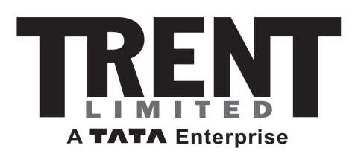

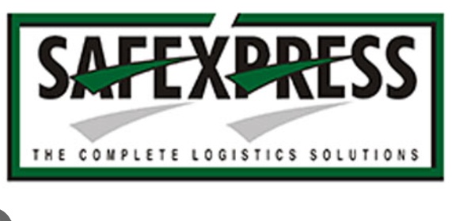








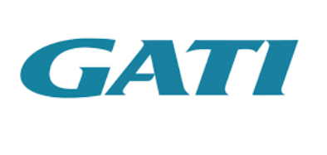





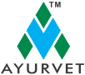

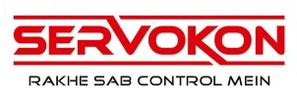

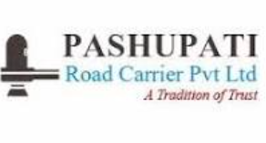
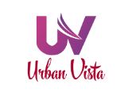

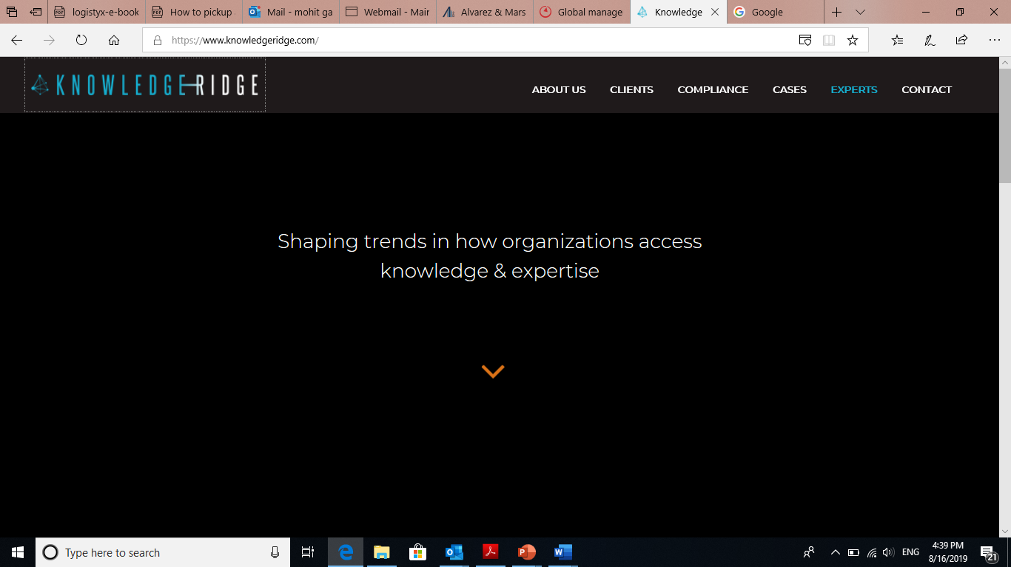
Key client segments
Creating incisive impact across client segments
Manufacturing/Retail
Consulting
Logistics / 3PL

Slide 9
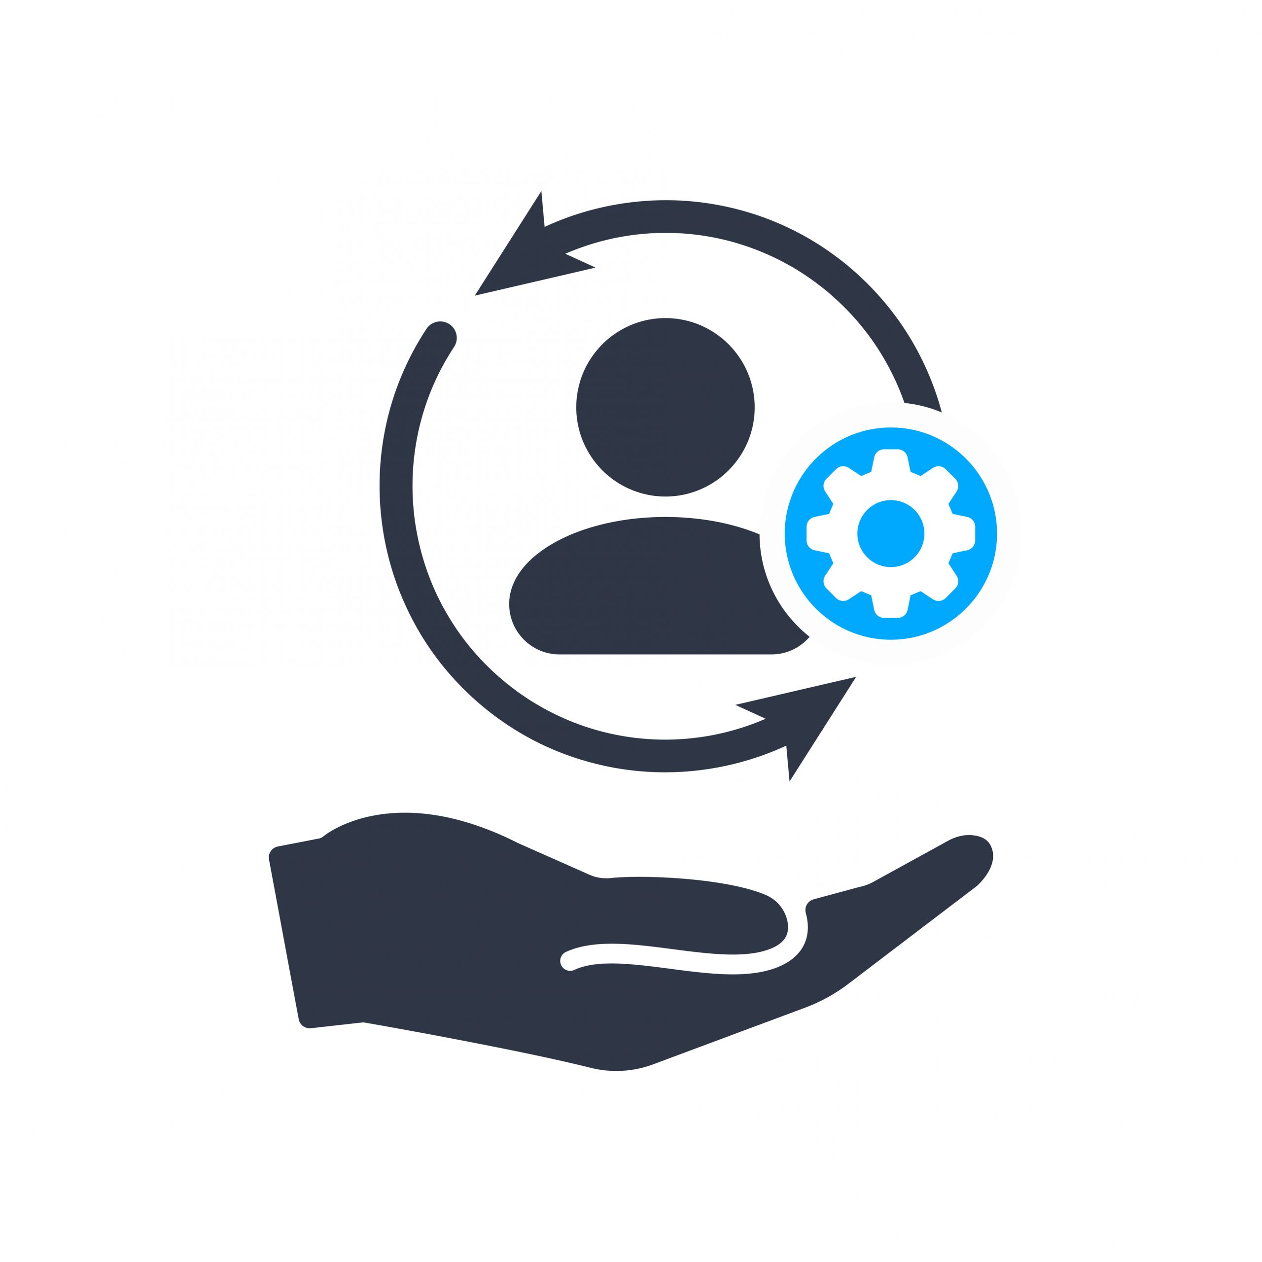
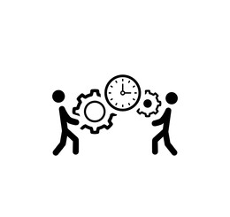


Engagement models
Flexible ways of working suiting specific requirements
Managed services
Project / Outcome based
Embedded team
Subscription based
Execution through proactively defining, monitoring, managing & improving processes
Control through outcomes, SLAs, KPIs
Full ownership for delivery and ability to influence the process
Cost of service is pre-agreed/fixed
Drive efficiency through CI, automation
One time ad hoc / intermittent activities requiring “on tap” support
Short duration of services (2-12 weeks)
Deployment of converged capabilities – technology, data, domain and business
Augment skills not available in house while maintaining responsibility for overall project/program management
Ongoing process requiring business knowledge
Basket of work requiring similar skills
Fully integrated with client’s team
Access to underlying product / solution
Pricing through no. of licenses, volume of usage and/or period of time
Benefits
Outcome-based engagement
Fill skill gaps while running processes efficiently
Continuous improvement
Flexibility
Less supervision required
Benefits
Flexibility
Resource mix will ensure that multiple project requirements are met
Provides mitigation for resource attrition
Benefits
Dedicated resources for the activity
Provisioning of lacking skills
Business knowledge is retained
Cost arbitrage
Better perceived control
Benefits
Better predictability
Lower cost for a committed engagement
We offer various pricing models which are fit-for-purpose for clients’ need:
Time & Material | Fixed fee | Transaction based | License based | Outcome based (Gain / Value share)

Slide 10
Why offshore supply chain activities to India?
Lower operating cost | Established model | Business resilience | Digital and data | Talent pool | Continuous improvement
1
2
3
Lower operating cost
Upto ~87% cost savings on resources (source: Everest Consulting, 2023)
Shift from fixed operating cost and capital cost to variable operating cost
Established offshore delivery model
Globalization, technology advancement enabling remote working, and increasing need of cost reduction are key drivers
~2.4mn FTEs are employed by offshore business services of global companies, in addition to a substantially higher number outsourced to third parties
India continues as the most popular offshore services destination accounting for ~50% of the deployed headcount
Business resilience
Flexibility in ramping up and down
Strategic alliances with fewer but reliable outsourcing providers can guarantee ongoing operations at times of disruption
Extending working hours of the organization through addition of time zones
4
5
6
Deep data and technology skills
The supply chains across the world are witnessing a digital shake-up. To ride this transformation companies need resources which are data and digital native
With its well matured ITeS ecosystem, India is well positioned to fulfill such need
Large experienced talent pool
Convergence of operational, supply chain domain and data & technology expertise requires multi-skilled employees
With its burgeoning domestic sector, India has access to abundant pool of experienced supply chain resources
Continuous improvement and innovation
The evolving operating model has established a process of continuous improvement and innovation in the offshored activities
These are also driven by underlying contractual obligations

Slide 11
Supply Chain Playbook

Slide 12
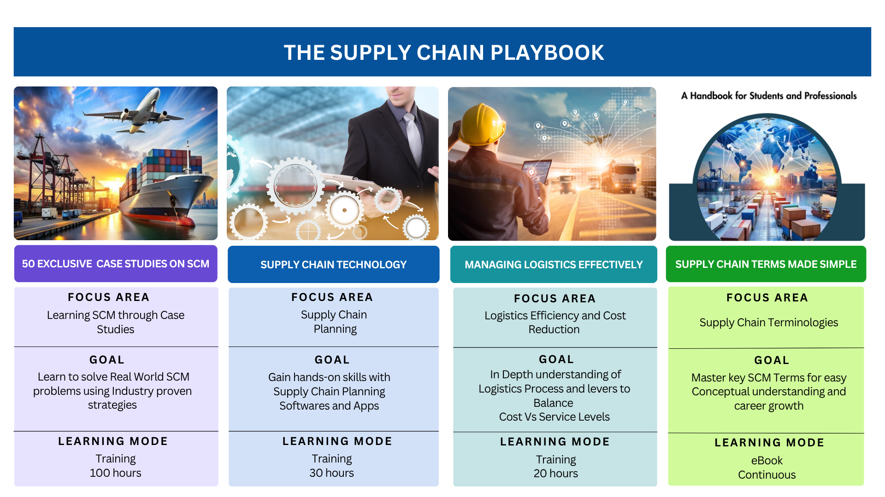

Slide 13
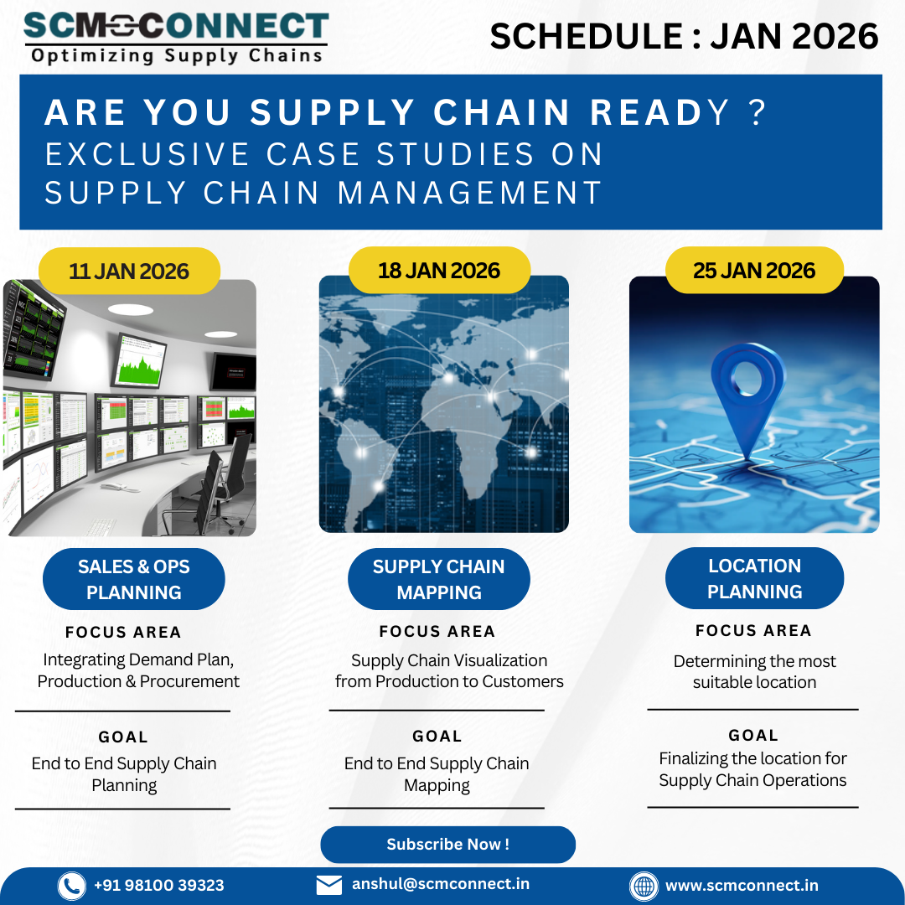
50 Exclusive Case Studies on
Supply Chain Management
What will you learn?
Structuring a Supply Chain Problem
Sales & Operations Planning
Supply Chain Mapping – Upstream as well as Downstream
Location Planning to determine the most suitable location for the facility
Interpreting Results
Scenario based Simulations

Slide 14
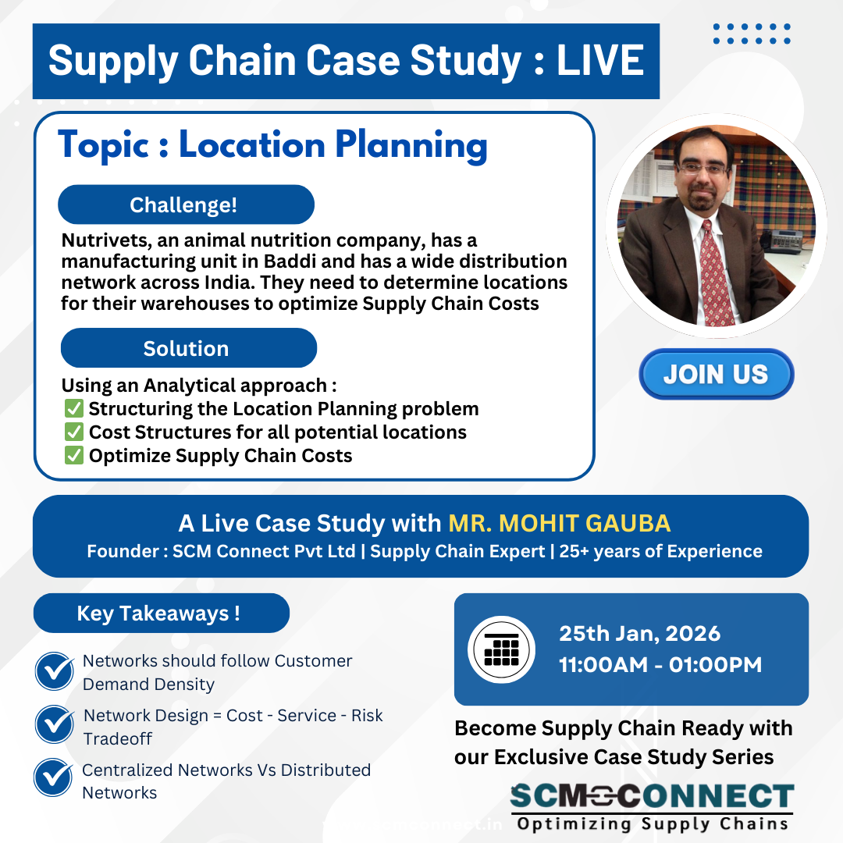
Case Study : Location Planning
25-Jan-2025
What will you learn?
Structuring the Location Planning Problem
Data Requirements
Demand Density (Locations | Quantum)
Distance Matrix
Supply Chain Costs
Inbound | Warehousing | Outbound
Optimize Supply Chain Costs
Trade-offs between Costs and Service Levels
Interpreting Results
Scenario based Simulations

Slide 15
Supply Chain Cost Components
India has one of the highest supply chain costs in the world
India has one of the lowest logistics cost in INR/Kg in the world
Potential reduction of inventory cost by up to $100-150bn in India
Reducing the costs while improving service levels is essential for Make in India
Concept of VALUE DENSITY

Slide 16
Key Concepts : Location Planning
Location Planning is the process of deciding
How many facilities? (plants, DCs, warehouses)
Where to locate them?
What role each location plays? (manufacturing, storage, cross-dock, fulfillment)
…….so that Supply Chain meets cost, service, risk, and growth objectives
Why Location Planning Matters?
60–80% of total supply chain cost (transport + inventory + facilities)
Customer service levels (lead time, OTIF)
Scalability and resilience
Tax, duty, and regulatory exposure
Once fixed, locations are hard to reverse
Objectives
Minimize Total Landed Cost
Meet Service Level Targets
Reduce Risk
Enable Future Growth
Comply with Regulations
Decisions Involved
Types of Facilities
Manufacturing Plants
Central | Regional DC | Fulfillment Centres
Cross Docks
Filling Stations
Number of Locations
Centralized Networks
Few Locations – Low Fixed Cost, High Transportation Costs, Service Levels are low
Distributed Networks
Many Locations – High Fixed Cost , Low Transportation Costs, Higher Service Levels

Slide 17
Key Concepts : Location Planning
Factors Considered in Location Planning | Focus Areas
Demand Side | Customer Locations Demand Density Service Level Requirements
Supply Side | Supplier Locations Raw Material Availability Inbound Logistics Cost
Cost Factors | Transportation (Inbound | Outbound) Storage Costs Land, Labour, Utility Costs Taxes
Risk & Strategy | Regulatory Risk Natural Disaster Risk Single point of failure exposure Make to Order | Make to Stock

Slide 18
Key Concepts : Location Planning
Location Planning Models | Focus Areas
Factor Rating Method (Qualitative) | Labour Availability Infrastructure Ease of doing business
Centre of Gravity Method | Minimize Transportation Costs Based on Demand Volume and Distance Used for DC Location Selection
Network Optimization Models | Most Powerful # Facilities Locations Flow of Goods
Scenario Analysis | Centralized Vs Distributed 1 Vs 3 Vs 5 DCs Current Vs Future Demand

Slide 19
Key Concepts : Location Planning Vs Supply Chain Design
Aspect | Location Planning | Supply Chain Design
Scope | Narrower | Broader
Focus | Where to locate facilities | How the entire supply chain is structured
Key Question | Where should we operate? | How should we operate end-to-end?
Decisions Covered | Number & location of plants, DCs, warehouses | Network, flows, inventory, sourcing, transport, service
Dependency | Part of supply chain design | Uses location planning as an input

Slide 20
Key Concepts : Location Planning
Location Planning
Significant Changes in Demand Patterns
Change in Sourcing Policy
Change in Go-To Market Strategy
Cost Reduction
Improvement in Service Levels
Outsourcing Decisions
Changes in Government Policies`
Supply Chain Risk Mitigation
Geographical Expansion to Serve New Markets

Slide 21
Key Concepts : Location Planning
Benefits of Location Planning
Lower Total Supply Chain Costs
Right Sized Infrastructure
Scalability for Future Growth
Improved Customer Service Levels
Increased Flexibility & Resilience
Streamlined Operations
Tax and Regulatory Efficiency
Competitive Advantage

Slide 22
Use Cases of Location Planning
New Market Entry
Entering a New Region
Distribution Network Re-Design
Optimize number and location of DCs
Manufacturing Plant Location
Capacity Expansion | Greenfield project
Where to setup the Plant | DC
Balance RM proximity } Labour Costs and Market Access
Taxation
Tax structure changes
Cost Reduction Programs
Warehouse Consolidation
Risk Mitigation
Over dependence on one location
Government Incentives
Relocating DCs
Avoid single point of failure
Warehouse Location
Lead Times Vs Last Mile Delivery costs
Service Level targets
Service Level Improvement
Reduce Lead Times
Improve Fill rates and reduce lost sales

Slide 23
Collecting the Data
Demand Density
Demand per Location
Distance Matrix
DC to Customer Locations
Transportation Costs
Fixed and Variable Costs
Inbound transportation cost from Plant to DC
Outbound transportation cost from DC to Customers
Existing Lanes | New Lanes
Facility Costs
Fixed Cost
Variable Handling Cost
Capacity ( Plant and DC )
Product Flows
Actual Inbound to DC
Actual Outbound from DC to Customers

Slide 24
Building the Model
Create Baselines
Baseline 1 - Actual Flows
Map Actual Product Flows
Model Cost to reflect Actual Cost
Baseline 2 – Adhere to Policy
Ensure Outbound Flows from Dedicated DCs
Baseline 3 – Optimal DC
Optimize the Product Flow from DC to Customers
Keep # DCs as same
Simulate # DCs to Optimize Cost
Sensitivity Analysis for Level of Service (LoS)

Slide 25
Train to Gain
Exclusive Case Studies on Supply Chain Management

Slide 26
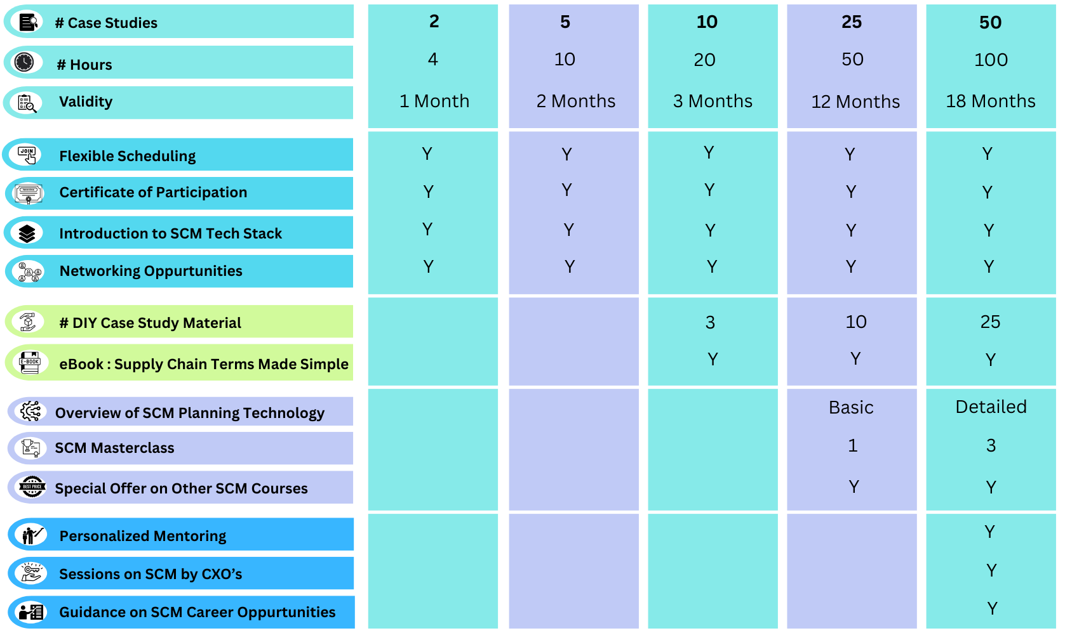
Exclusive Case Studies on Supply Chain Management

Slide 27
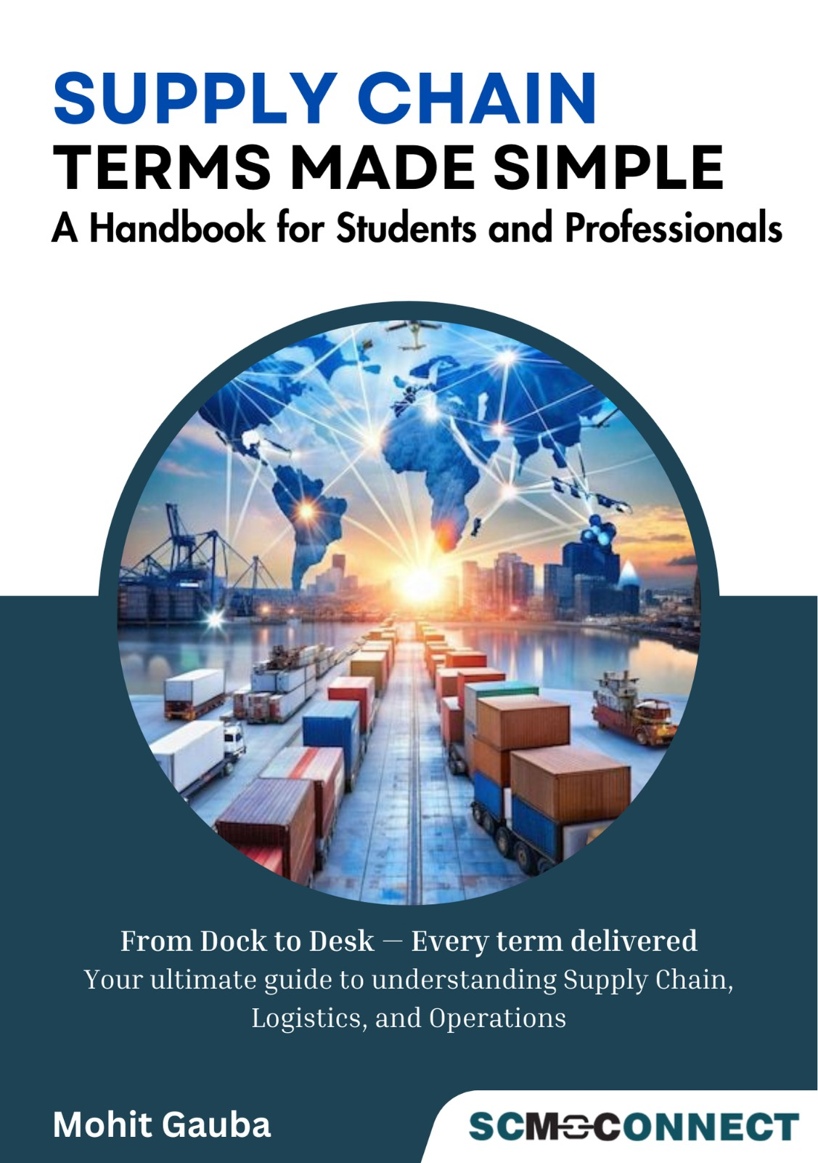
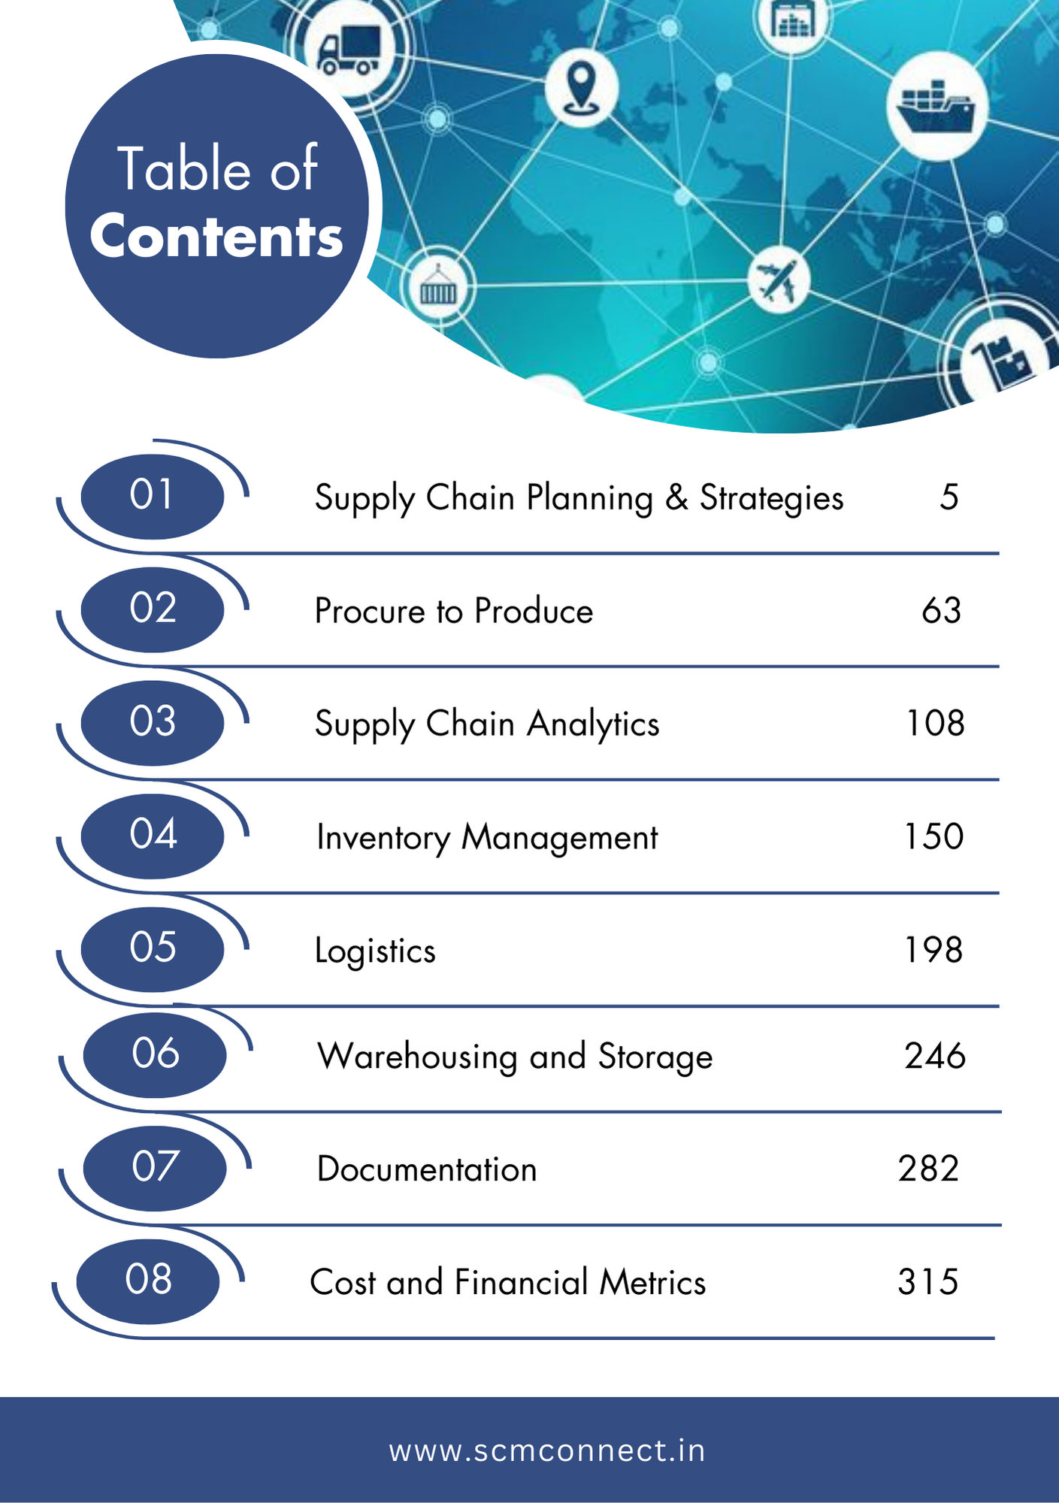
Supply Chain Terms Made Simple : eBook
23-May-2025

Slide 28
Welcome to Supply Chain Community ! Mohit Gauba Email : mohit.gauba@scmconnect.in Mobile : +91 98186 97696

